Slide 1
CIRCUITS

Slide 2
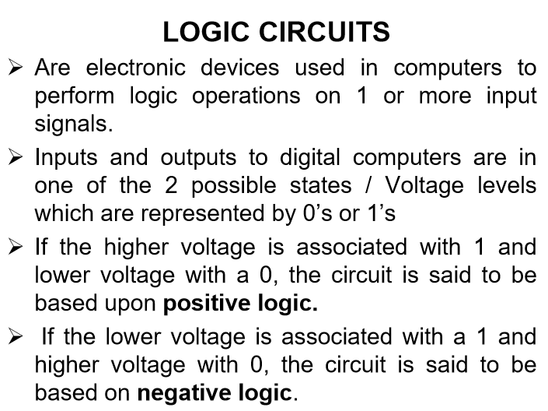

Slide 3
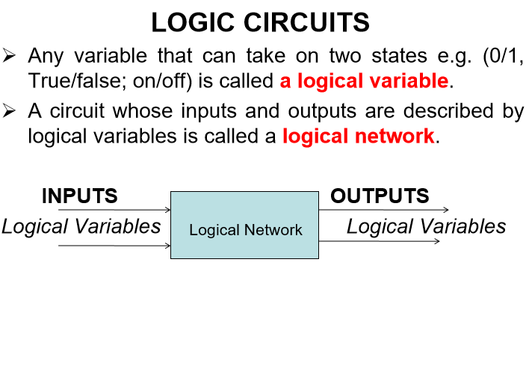

Slide 4
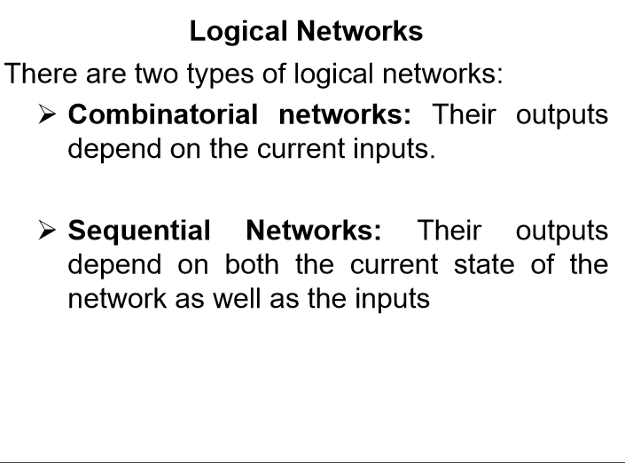

Slide 5
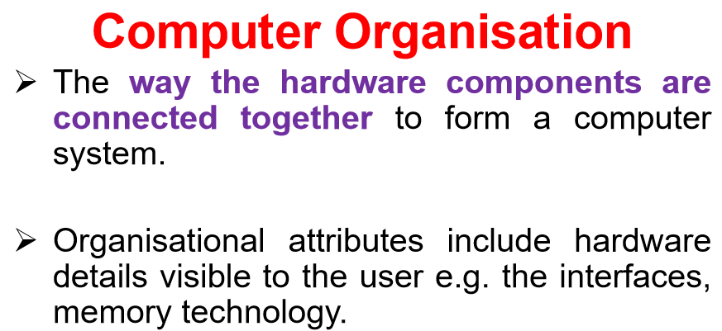

Slide 6
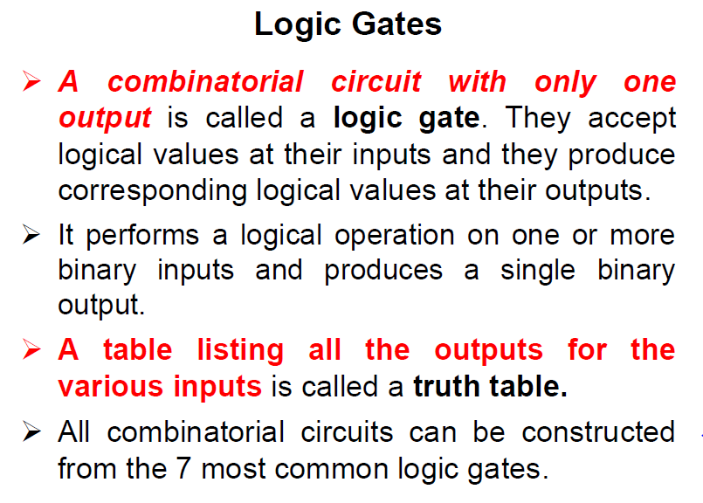

Slide 7
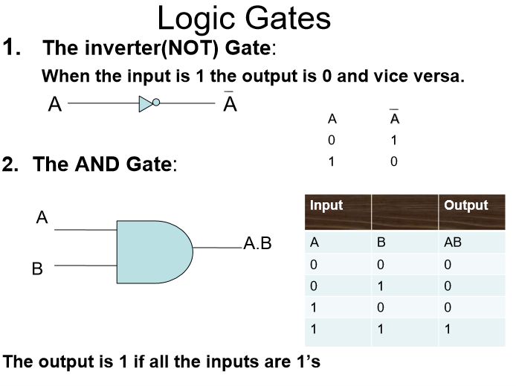

Slide 8
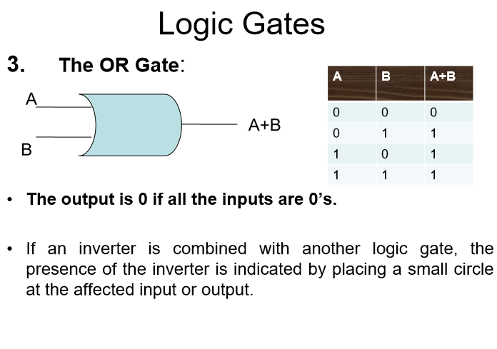

Slide 9
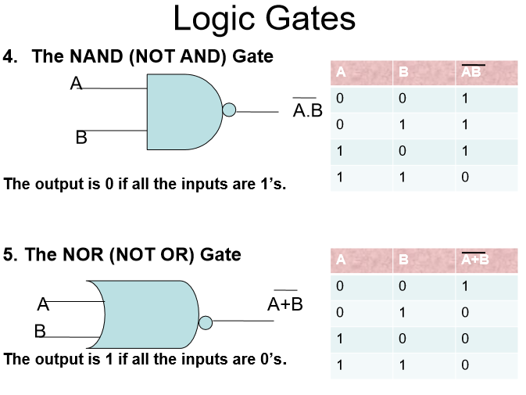

Slide 10
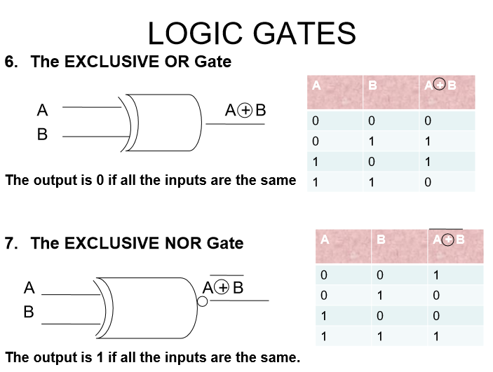

Slide 11
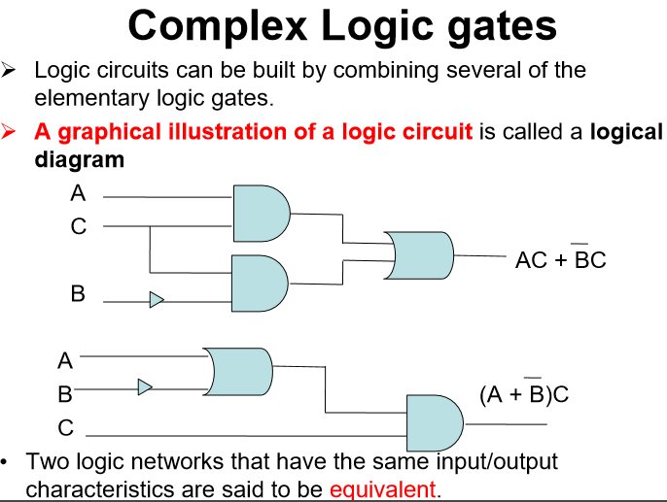

Slide 12
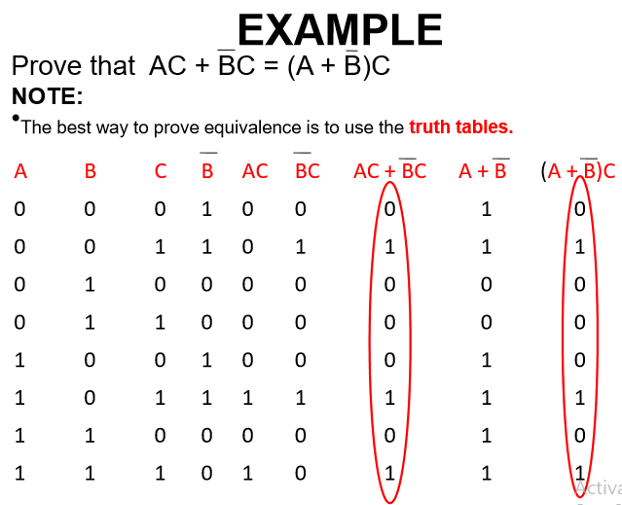

Slide 13
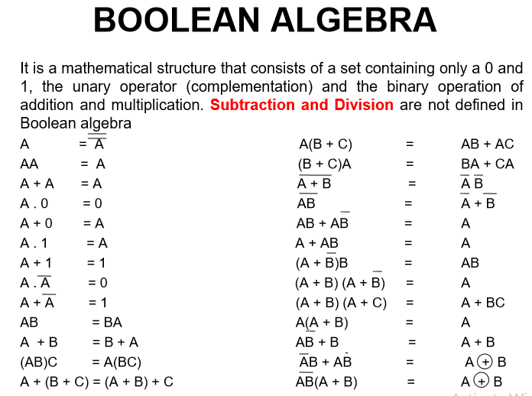

Slide 14
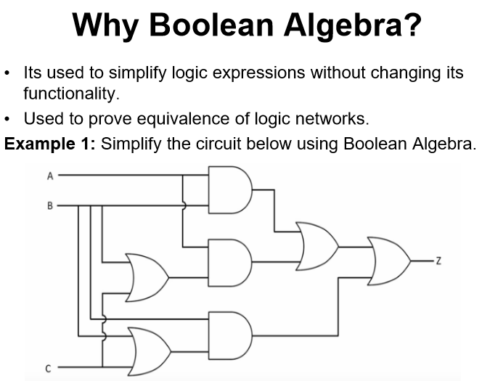

Slide 15
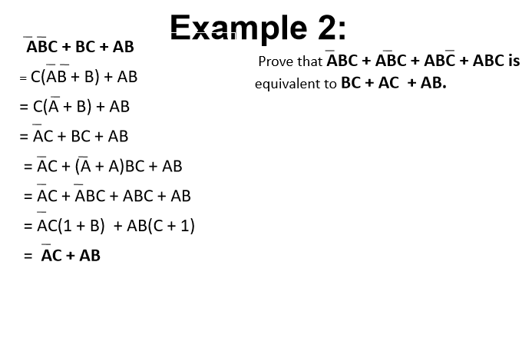

Slide 16
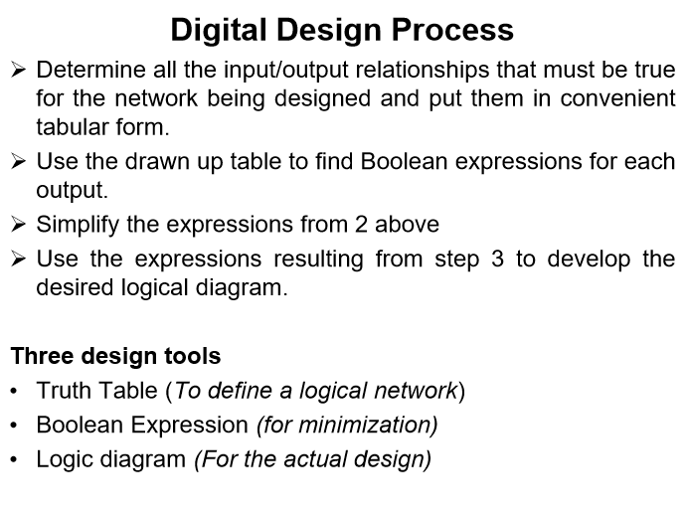

Slide 17
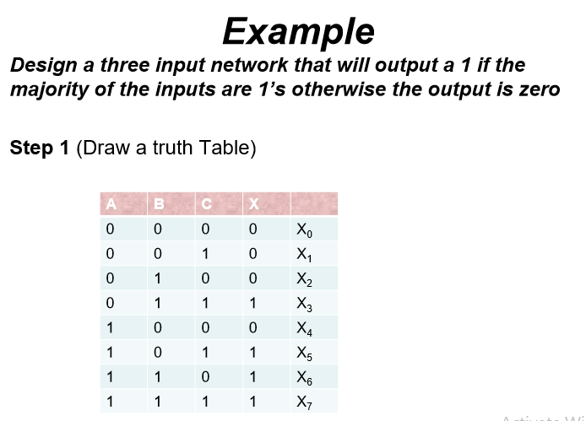

Slide 18
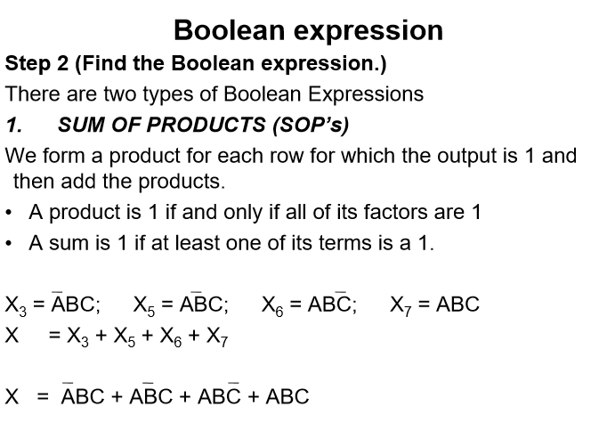

Slide 19
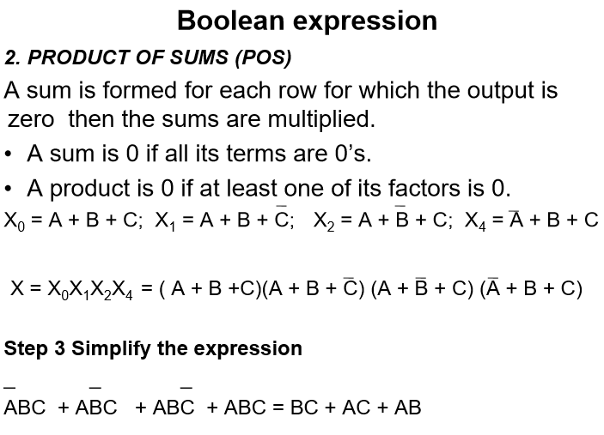

Slide 20
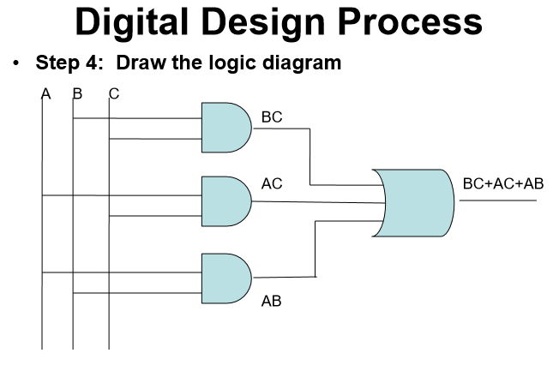

Slide 21
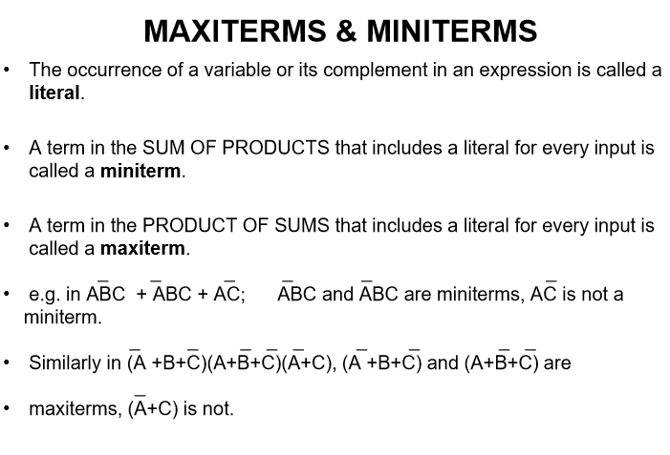

Slide 22
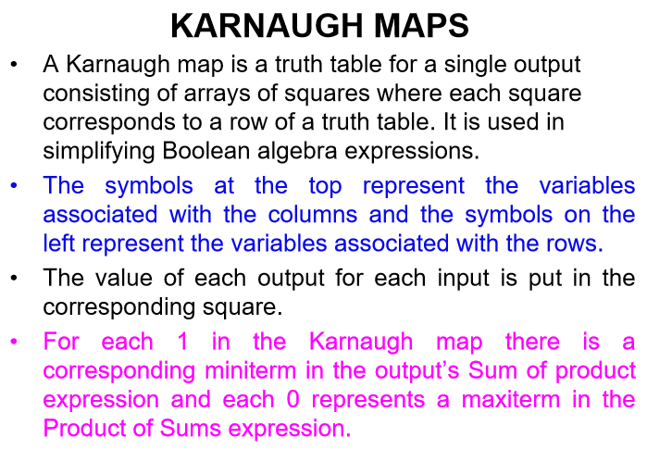

Slide 23
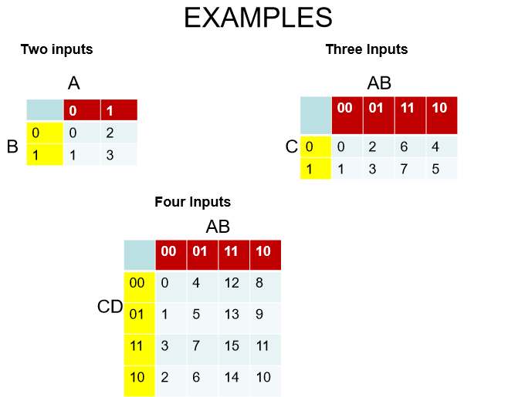

Slide 24
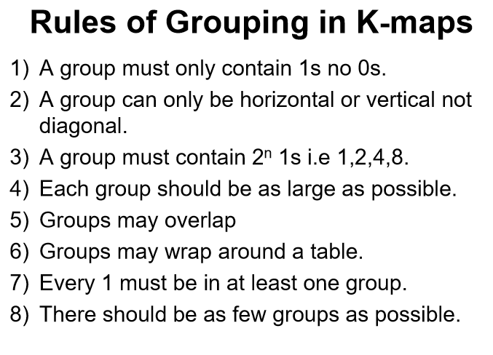

Slide 25
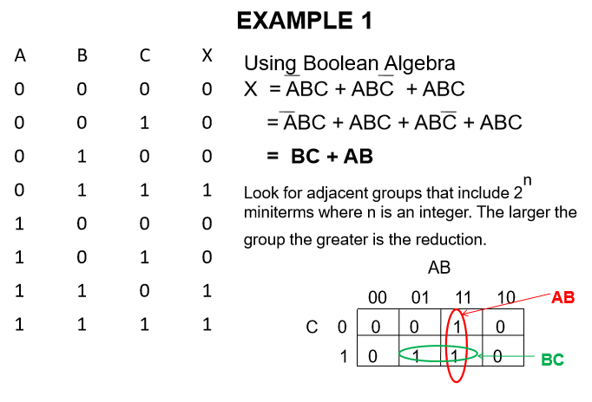

Slide 26
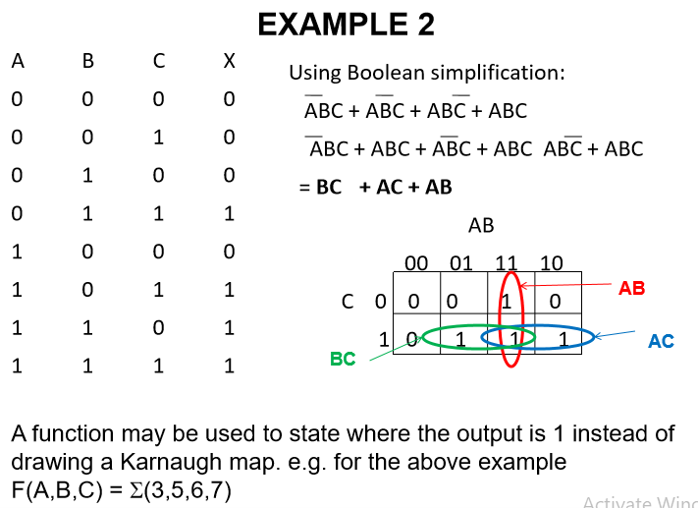

Slide 27
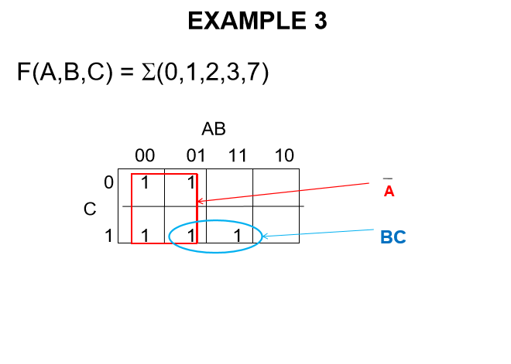

Slide 28
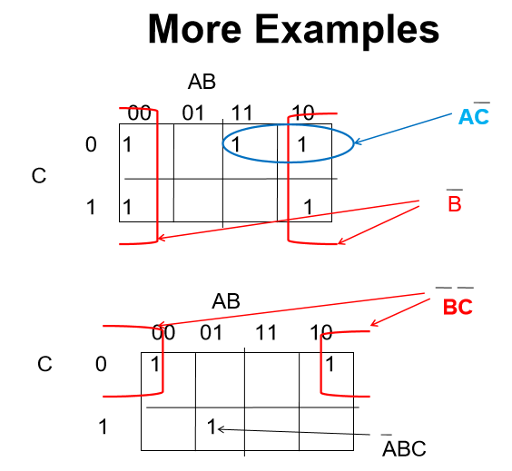

Slide 29
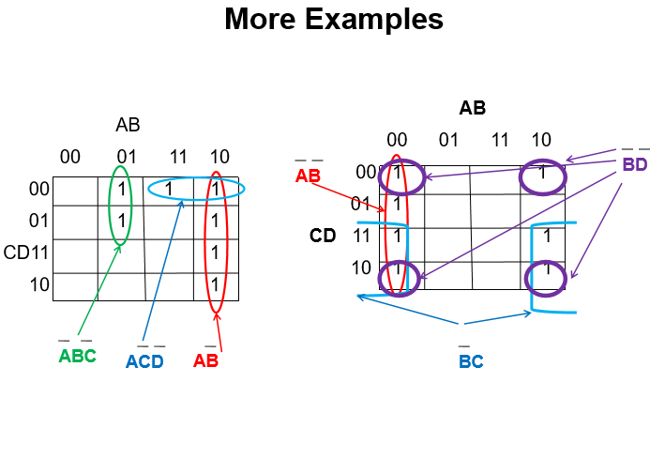

Slide 30
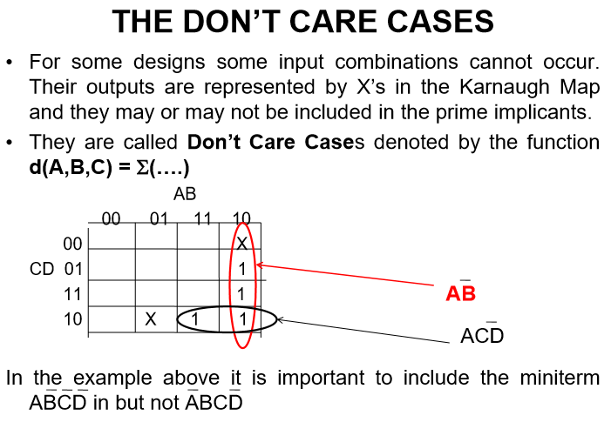

Slide 31
NOTE:
Read more about The Don’t care cases as used in Karnaugh maps.

Slide 32
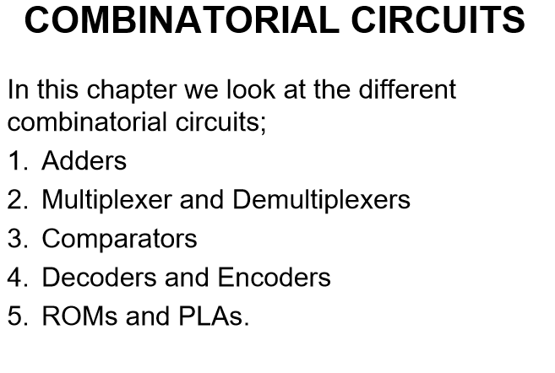

Slide 33
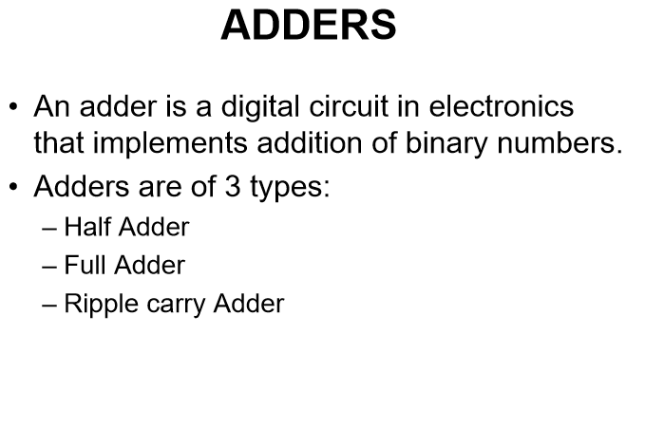

Slide 34
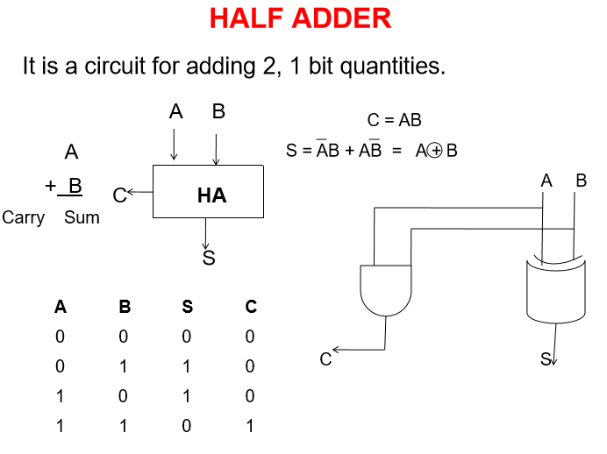

Slide 35
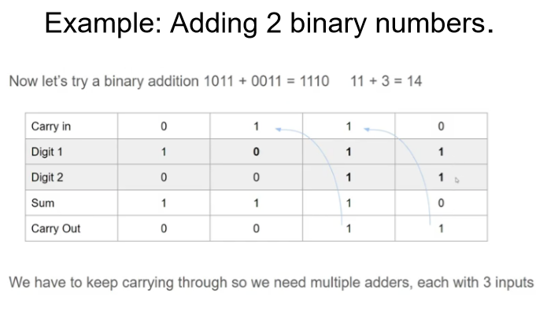

Slide 36
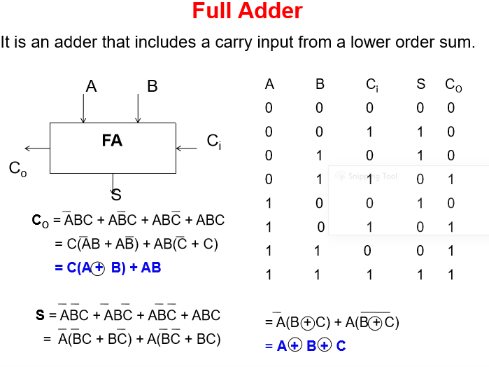

Slide 37
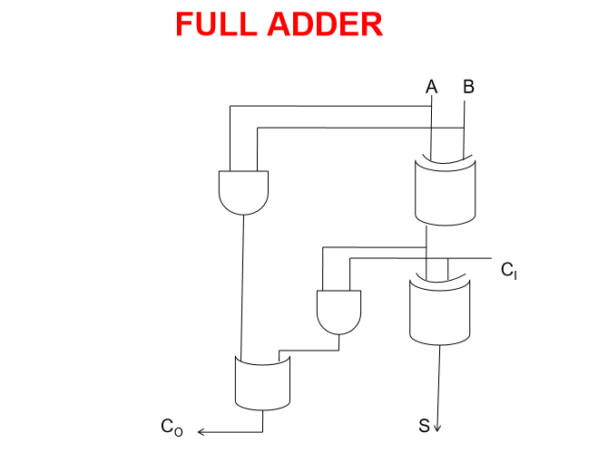

Slide 38
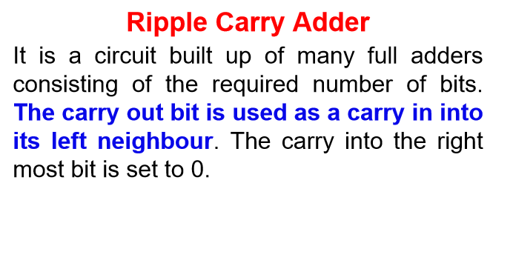

Slide 39
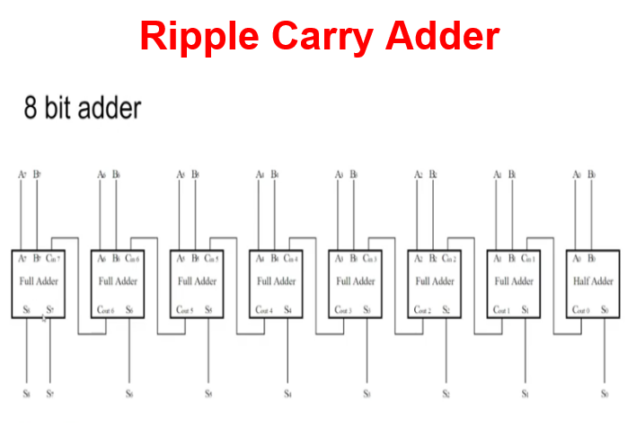

Slide 40
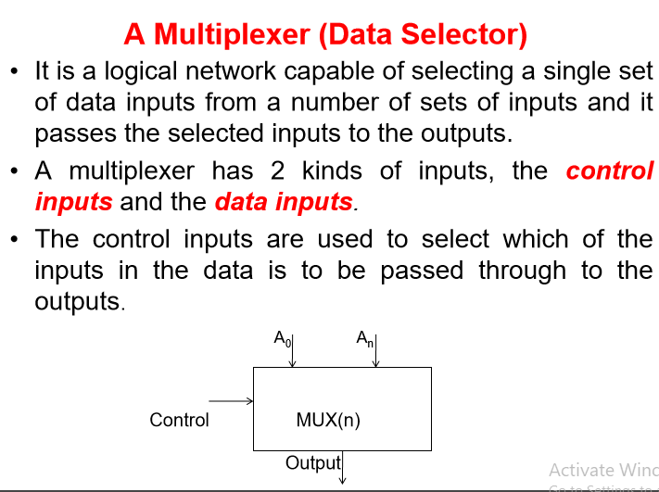

Slide 41
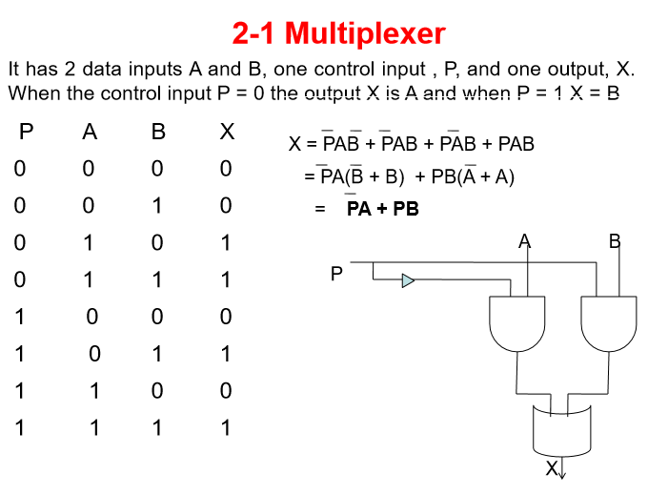

Slide 42
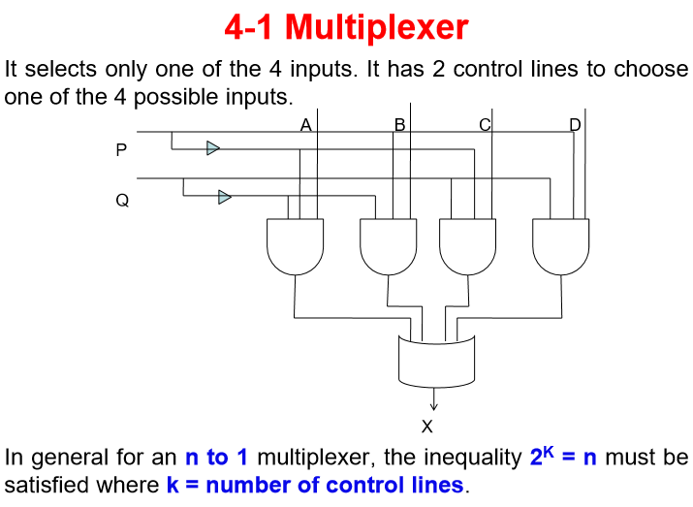

Slide 43
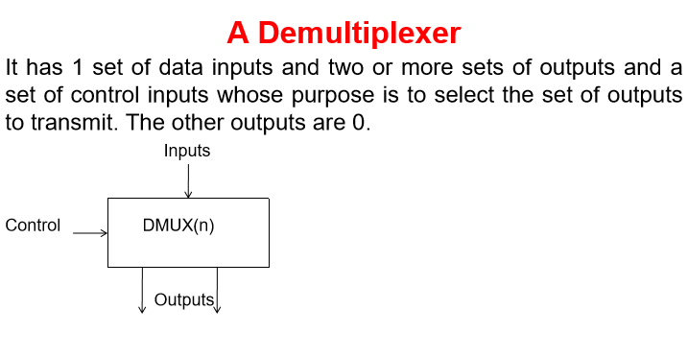

Slide 44
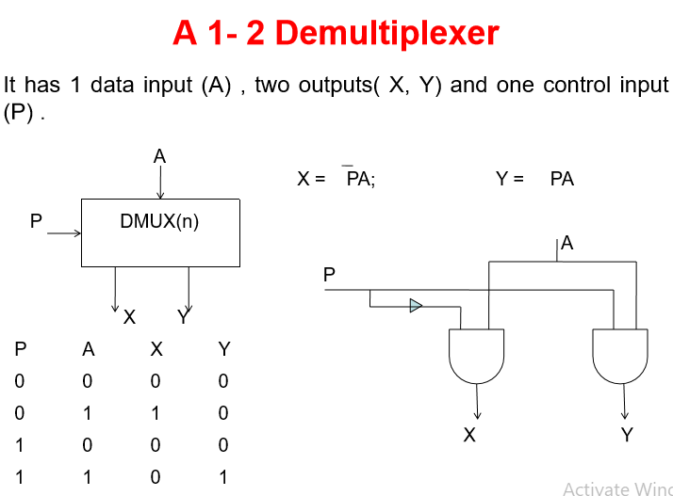

Slide 45
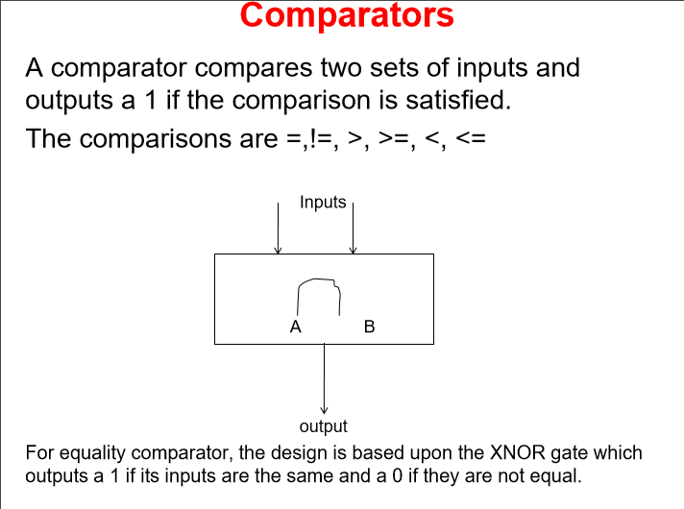

Slide 46
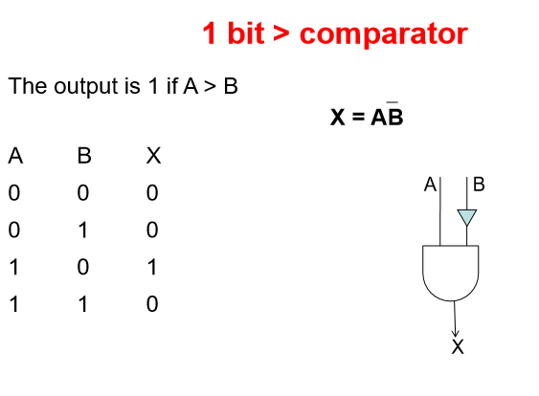

Slide 47
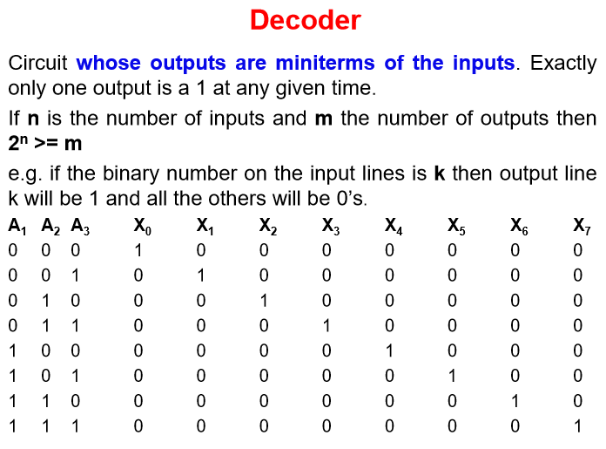

Slide 48
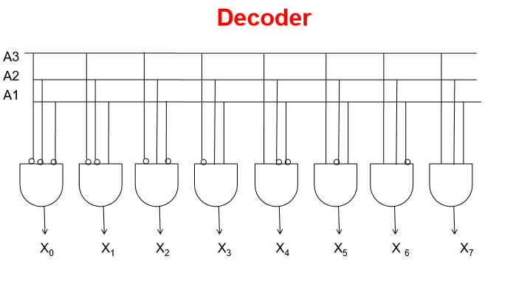

Slide 49
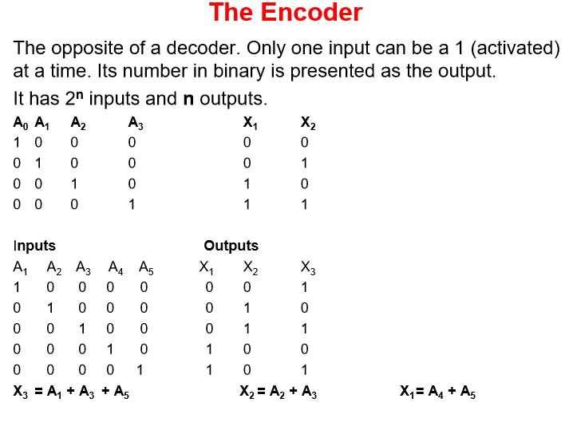

Slide 50
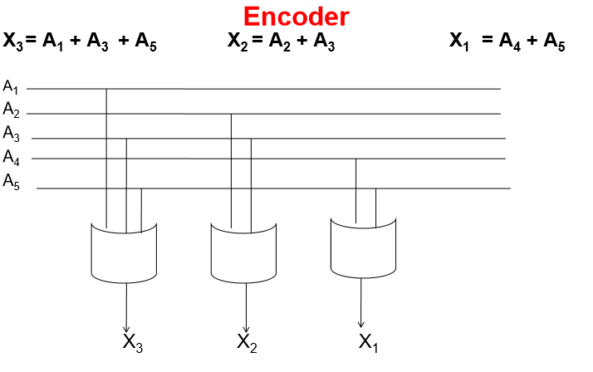

Slide 51
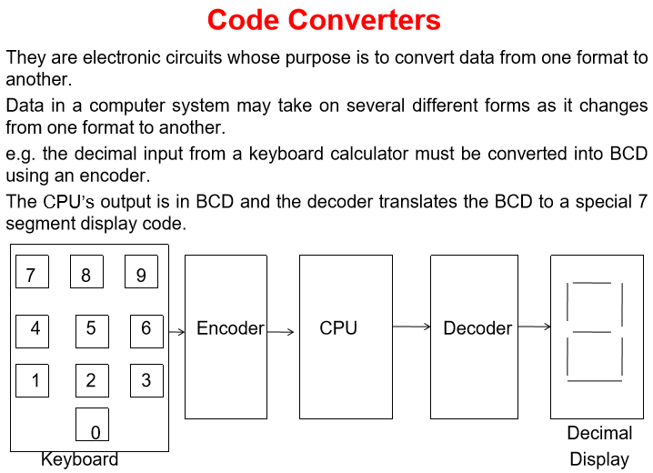

Slide 52
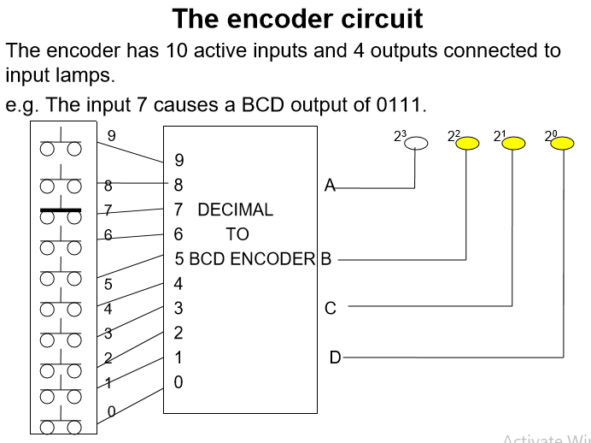

Slide 53


Slide 54


Slide 55
ROMS AND PLA’S
ROM (Read Only Memory)
Its circuit is equivalent to a decoder. It outputs all possible mini-terms of the inputs followed by an encoder.
The output combinations are permanently embedded in its circuitry and the inputs serve to select one of these combinations. Each output is obtained by disconnecting the OR inputs from the AND gates whose mini-terms are not to be included in the output.
Because a ROM must produce all the possible mini-terms its decoder portion is fixed by n (the number of inputs). The encoder portion depends on both the outputs and the way in which all the outputs of a decoder are used to generate the final ROM outputs.

Slide 56


Slide 57


Slide 58


Slide 59


Slide 60


Slide 61
Sequential Circuits
.

Slide 62
SEQUENTIAL LOGIC & COMPUTER CIRCUITS
In sequential circuits, the output depends on the current input as well as past output/outputs (current state).
Whereas in combinatorial circuits the output depends only on the present values of the input, at any instant of time.
Sequential circuit can be considered as combinational circuit with feedback circuit.
Sequential circuit uses a memory element as feedback circuit in order to store past values.
The information stored in sequential circuits represents current state of the circuit.
The current state and current input will define output and the next state of the circuit.

Slide 63


Slide 64
Examples of sequential circuits
Counting device
Memory circuit

Slide 65
SEQUENTIAL LOGIC & COMPUTER CIRCUITS
Time in a sequential circuit takes on a significant role.
A sequential network is defined according to its inputs and outputs over a period of time.
In sequential networks, a truth table is not enough to show input/output relationships because it ignores time.
The aid used in examining the time dependent aspect of a sequential network is called a timing diagram

Slide 66


Slide 67


Slide 68


Slide 69


Slide 70
THE R-S FLIP -FLOP
It has 3 inputs S(Set), R (Reset) and C (a clock input) which synchronises the action of the flip-flop with its surrounding
The two outputs (Q and Q) are always in opposite states from each other.
Most significant changes occur when there is a clock transition.
If the clock input is constant, the outputs will follow the changes in the inputs at all times.
When the clock is in 0 state Both R and S inputs have no effect on the state of the flip-flop. The network is then stable. In this state, if Q = 1, Q is = 0 and Q is maintained at 1. If Q is 1, Q = 0 and Q is maintained at 1.
If the clock is raised to 1 the network will not change if R = S = 0
The subscripts Q- and Q- indicate outputs just before the clock becomes 1 and the subscripts Q+ and Q+ show outputs just after the clock becomes 1

Slide 71


Slide 72


Slide 73


Slide 74


Slide 75


Slide 76


Slide 77


Slide 78


Slide 79


Slide 80
REGISTERS
Transfer of new information into the register is known as loading the register.
If all bits of the register are loaded at the same time we say that the loading is done in parallel.

Slide 81
Shift registers
Shift registers are classified according to input and output which maybe either serial or parallel.
A serial input is one for which the input arrives 1 bit at a time, and each time a bit arrives the register is shifted by one to accommodate the new bit.
A parallel input is one for which the inputs are all loaded at the same time.
If the left most bit is brought around and put in the right bit during a left shift, or the right most bit is put in the left bit during a right shift the operation is called a rotation.

Slide 82
Shift registers
The Shift Register is another type of sequential logic circuit that can be used for the storage or the transfer of binary data.
They are capable of shifting their bits either to the left or to the right. They have a tendency of rearranging their contents.
If an 8 bit register contains 0 1 1 0 0 1 0 1 and a left shift operation is performed, the new contents of the register will be;
1 1 0 0 1 0 1 0.
A 1 bit right shift would result into
0 0 1 1 0 0 1 0

Slide 83
Example
Consider initially A = 01101001 and the carry flag (c) = 1

Slide 84


Slide 85


Slide 86


Slide 87
Data Transmission
A transmission that is controlled by a common clock signal is said to be synchronous.
A transmission that is not controlled by a common clock signal is said to be asynchronous.
The logical 1 and logical 0 are respectively knows as the mark and space.

Slide 88


Slide 89


